Slide 1
7FNCE040W
Business Analytics
WEEK 6 Bite 2

Slide 2
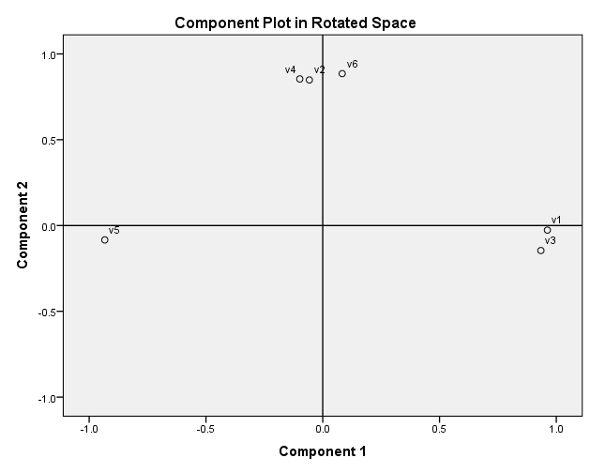
Toothpaste example continued Rotated Factor Loading Plot
Notes:
“Rotation” – mathematical transformation on the solution to enhance interpretation
By rotating the factors:
We would like each factor to have nonzero, or significant, loadings or coefficients for only some of the variables.
We would like each variable to have nonzero or significant loadings with only a few factors, if possible with only one.
This is shown by falling close to one axix.

Slide 3
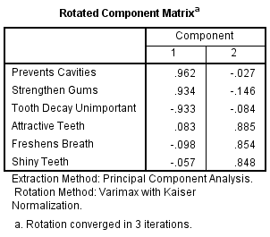
SPSS Output - Rotated Factor Loadings
This matrix shows which variables are correlated with each component
Each variable has a high loading on one factor, but not both
Use this information to name the component
Component 1: “health”
Component 2: “beauty”
Notes:
Rotation aids interpretation
Rotation does not add explanation of variance
By looking at the variables that support Component 1 – what would you name this factor?
Prevents cavities
Strengthens gums
Tooth decay unimportant
By looking at the variables that support Component 2 – what would you name this factor?
Attractive teeth
Freshens breath
Shiny teeth

Slide 4
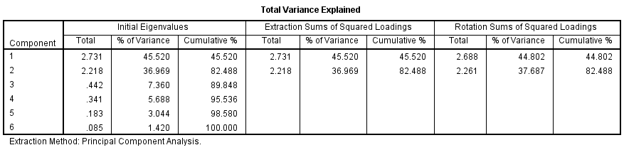
SPSS Output – Variance Explained
Rotation aids interpretation
Rotation does not add explanation of variance
Notes:
The rotation does not help explain additional variance. The contribution of each factor may have changed, but no additional variation has been accounted for, or lost.
The last 3 columns show the rotated solution.
The rotation does not help explain additional variation
The contribution of each factor may changed, but no additional variation has been accounted for, or lost.

Slide 5
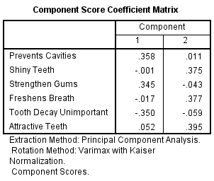
SPSS Output – Factor Scores
These are the actual weights (w_{ij}’s)used to transform the standardized variables (x’s) to get the component scores (f’s).
For each observation, the data set has two new variables.

Slide 6
SPSS Output – Factor Scores
For each respondent:
Factor 1 = (.358)(cavities) + (-.001)(shiny) + … + (.052)(attractive)
Factor 2 = (.011)(cavities) + (.375)(shiny) + … + (.395)(attractive)
Notes:
In the regression above, where it says cavities or shiny, etc you could insert the standardized value of each of these variables for a particular person and calculate the value of Factor 1 and Factor 2 saved into the data file.
Then these 2 new variables could be used in further analysis instead of the original 6 variables

Slide 7
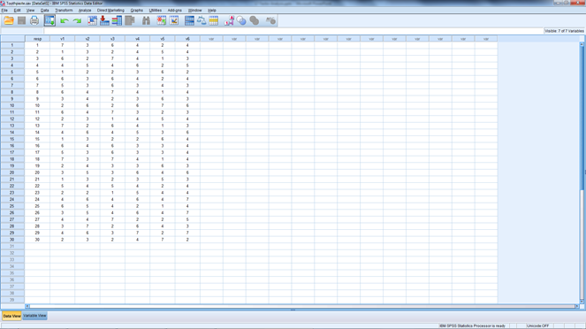
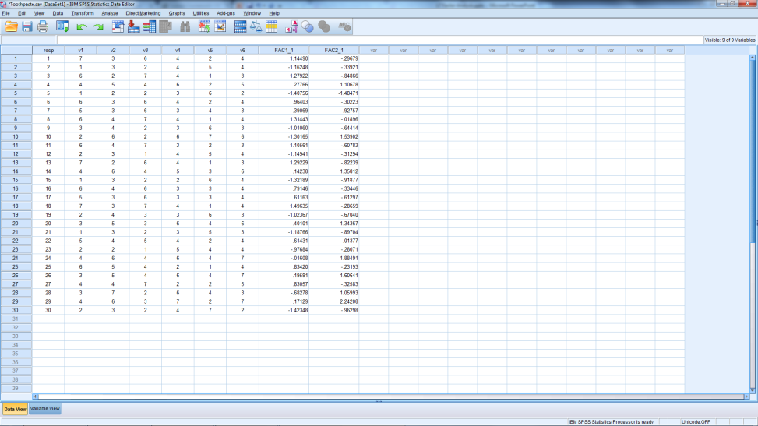
EFA / PCA
Starting Data: Several Variables per Respondent
Ending Data: Factor Scores per Respondent
Notes:
Using these new variables instead of the original variables – more parsimonious.

Slide 8
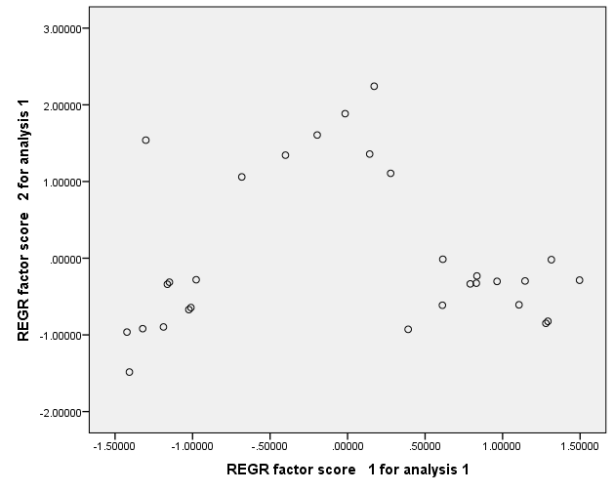
Map of Toothpaste Consumers
Notes:
What can we learn from this “picture” of consumers?

Slide 9
Definitions
Reliable
The extent to which a scale produces consistent results if repeated measurements are made on the characteristic
Valid
The extent to which differences in observed scale scores reflect true differences among objects on the characteristic being measured
Assessed with Coefficient α
Are you measuring what you set out to measure?
Notes:
Reliability:
The portion of measurement that is due to permanent effects that persist from sample to sample
The extent to which a scale produces consistent results if repeated measurement are made on the characteristic
Assessed with Coefficients alpha
Validity:
The extent to which a rating scale truly reflects the underlying variable it is attempting to measure.
The extent to which differences in observed scale scores reflect true differences among objects on the characteristics being measured
Are you measuring what you set out to measure?

Slide 10
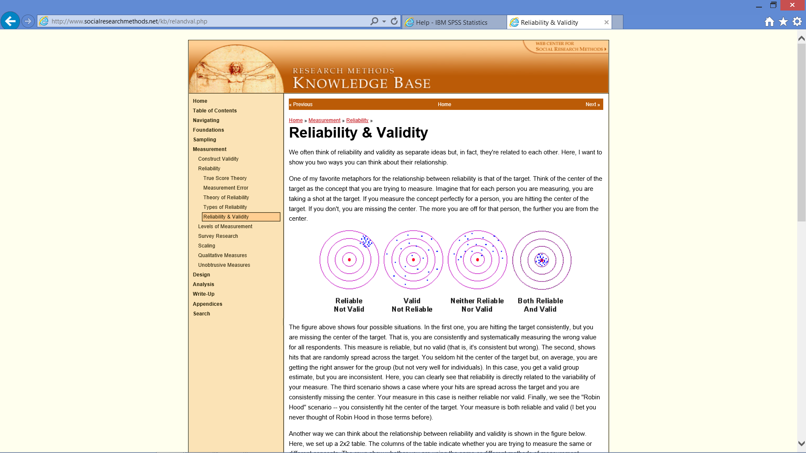
Validity and Reliability
Notes:
Think of the centre of the target as the concept that you are trying to measure. Imagine that for each person you are measuring, you are taking a shot at the target. If you measure the concept perfectly for a person, you are hitting the centre of the target. If you don't, you are missing the centre. The more you are off for that person, the further you are from the centre.
In the first one, you are hitting the target consistently, but you are missing the centre of the target. That is, you are consistently and systematically measuring the wrong value for all respondents. This measure is reliable, but not valid (that is, it's consistent but wrong).
The second, shows hits that are randomly spread across the target. You seldom hit the centre of the target but, on average, you are getting the right answer for the group (but not very well for individuals). In this case, you get a valid group estimate, but you are inconsistent.
Here, you can clearly see that reliability is directly related to the variability of your measure. The third scenario shows a case where your hits are spread across the target and you are consistently missing the centre. Your measure in this case is neither reliable nor valid.
Finally, we see the best scenario -- you consistently hit the centre of the target. Your measure is both reliable and valid.

Slide 11
Construct Validity
Construct Validity
Discriminant Validity
Convergent Validity
Notes:
Construct validity refers to the degree to which inferences can legitimately be made from the operationalisations in your study to the theoretical constructs on which those operationalisations were based.
Construct validity assesses the nature of the underlying variable or construct measured by the scale, but examining the scale’s convergent and discriminant validity.

Slide 12
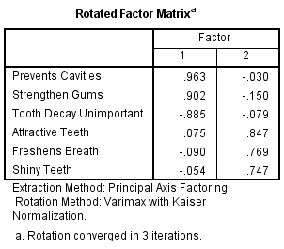
Construct Validity
Convergent validity
The variables are highly correlated with the factor
All items > .75
Depends on sample size
See table in notes
Discriminant validity
The factors are not correlated with each other
Each variables falls into just one factor
Limited or no overlap
Difference >.2
Otherwise delete variable
Notes:
Anal→ Dimen Red→ Factor → Roatation –’tick’ Varimax; ‘tick’ Loading Plots → Extraction (UNTICK) → Cont. → OK
Convergent validity means that the variables within a single factor are highly correlated. This is evident by the factor loadings.
Sufficient/significant loadings depend on the sample size of your dataset. The table below outlines the thresholds for sufficient/significant factor loadings. Generally, the smaller the sample size, the higher the required loading.
Sample size: 50 Sufficient Factor Loading: 0.75
Sample size: 60 Sufficient Factor Loading: 0.70
Sample size: 70 Sufficient Factor Loading: 0.65
Sample size: 85 Sufficient Factor Loading: 0.60
Sample size: 100 Sufficient Factor Loading: 0.55
Sample size: 120 Sufficient Factor Loading: 0.50
Sample size: 150 Sufficient Factor Loading: 0.45
Sample size: 200 Sufficient Factor Loading: 0.40
Sample size: 250 Sufficient Factor Loading: 0.35
Sample size: 350 Sufficient Factor Loading: 0.30
Discriminant validity: Variables should load significantly onto only one factor. If ‘cross=loadings’ do exist (a variable loads on multiple factors), then the variable should be remove. Cross-loadings should differ by more than 0.2.

Slide 13
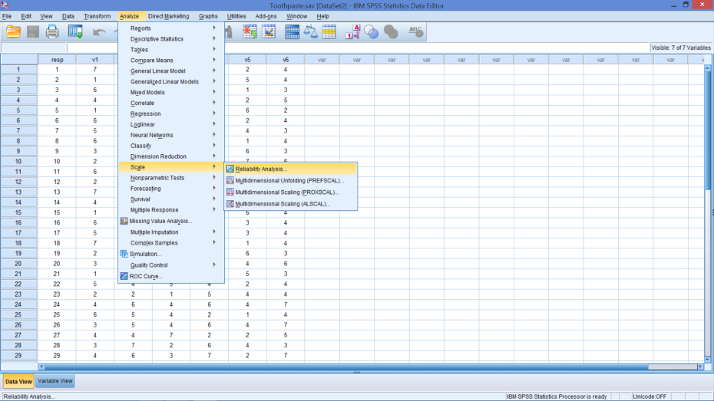
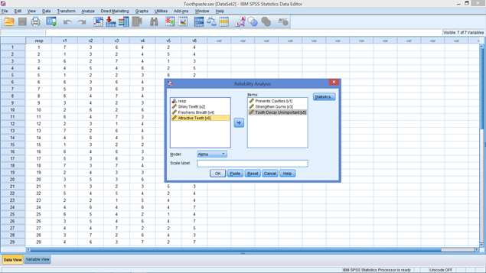
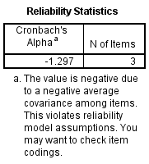
Reliability
Check coefficient alpha for factor 1
Analyse
Scale → Reliability Analysis
V1, V3, V5
Notes:
In the Statistics box under Descriptives:
Item
Scale
Scale if Item deleted
Cocharan chi-sq
Coefficient (Cronbach’s) Alpha
Range: 0-1
Typical cut-off value: 0.6 [0.7] (Nunnally 1978) (should be less than ..)
Note: This looks wrong and a warning is provided by SPSS
What could be the problem?
One of the items in factor 1 is negatively correlated with the factor, while the others are positively correlated.

Slide 14
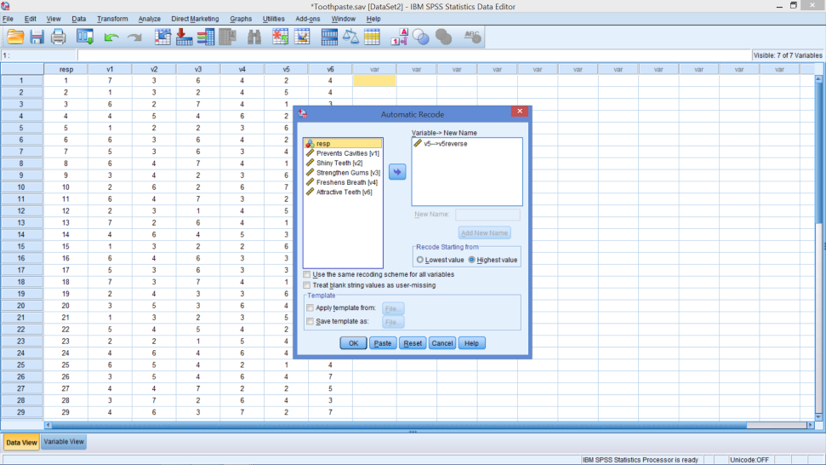
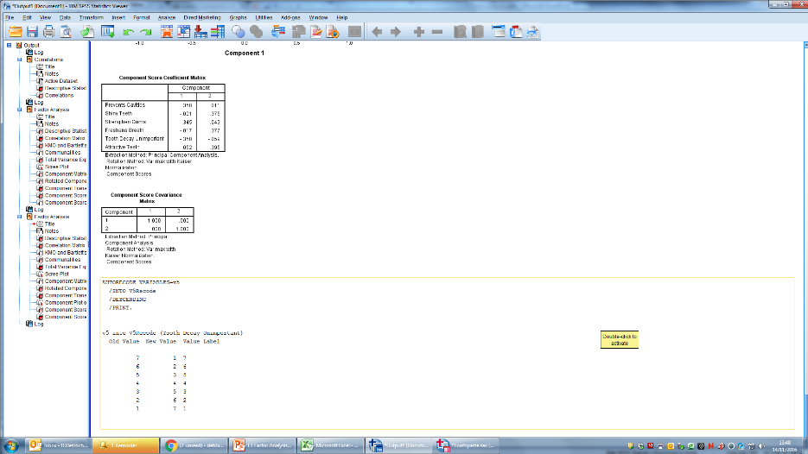
Automatic Recode
Dialog Box
Output Screen
Notes:
Transform
Automatic Recode
Select V5
Insert new name: V5Recode
Select: Add New Name
Tick: Recode Starting from Highest value
Click ‘OK’
(Anal…> Scale…> Rel Anal)

Slide 15
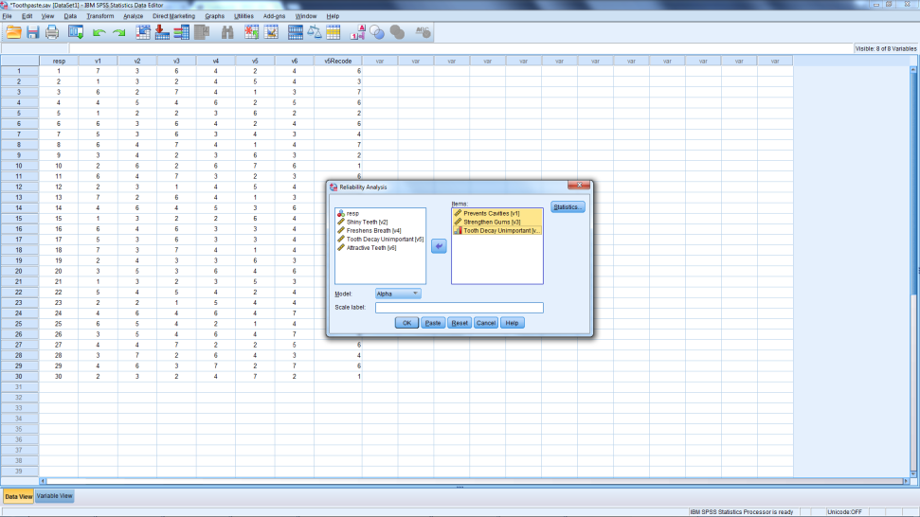
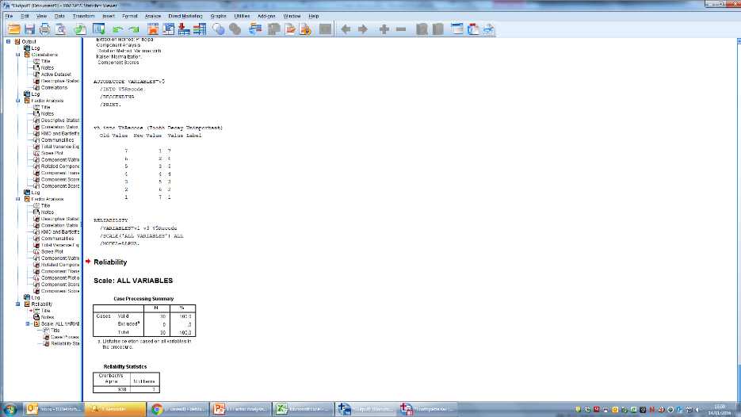
New Reliability
Notes:
Nunnaly (1978) has indicated 0.7 to be an acceptable reliability coefficient but lower thresholds are sometimes used in the literature.
Particularly for new scales.
It seems fairly common to describe Cronbach's alpha values as follows:
α ≥ 0.9 Excellent
0.7 ≤ α < 0.9 Good
0.6 ≤ α < 0.7 Acceptable
0.5 ≤ α < 0.6 Poor
α < 0.5 Unacceptable

Slide 16
Factor Analysis
Key Decisions

Slide 17
Key Decisions in Factor Analysis
Should factor analysis be applied to the data?
How many factors should be retained in solution?
Should the initial solution be rotated, and if so, using what rotation scheme?
Which extraction method should be used?
Notes:
Based on Churchill and Iacobucci (2005), Figure 18.8, page 583.
For factor analysis to be appropriate, the variables must be correlated. If the correlations are small, factor analysis may not be appropriate. Factor analysis does not work well if many of the variables are dummy variables.
Typically, principal components is the factor model used, but others are available, but others are available.
How many factors should be maintained? We used the scree plot, eigenvalue > 1, and % of variance explained to make a decision. Too few factors the output is difficult to interpret, and too many factors is inconsistent with the objective. However, too many is preferred to too few.
Rotation aids interpretation, but does not add additional explanation. So, can experiment with various rotation methods, though varimax is the most popular.
Note: Typically, factor analysis is carried out variable by variables (as here) but there may be occasions where the analysis is object by object.

Slide 18
Should Factor Analysis be used?
Correlations
KMO Measure of Sampling Adequacy
Bartlett’s Test of Sphericity

Slide 19
Key Decisions in Factor Analysis
Should factor analysis be applied to the data?
How many factors should be retained in solution?
Should the initial solution be rotated, and if so, using what rotation scheme?
Which extraction method should be used?
Notes:
Based on Churchill and Iacobucci (2005), Figure 18.8, page 583.
For factor analysis to be appropriate, the variables must be correlated. If the correlations are small, factor analysis may not be appropriate. Factor analysis does not work well if many of the variables are dummy variables.
Typically, principal components is the factor model used, but others are available.
How many factors should be maintained? We used the scree plot, eigenvalue > 1, and % of variance explained to make a decision. Too few factors the output is difficult to interpret, and too many factors is inconsistent with the objective. However, too many is preferred to too few.
Rotation aids interpretation, but does not add additional explanation. So, can experiment with various rotation methods, though varimax is the most popular.
Note: Typically, factor analysis is carried out variable by variables (as here) but there may be occasions where the analysis is object by object.

Slide 20
Confirmatory Factor Analysis
What’s different?
Method
You know which variables (columns) should go together
3 – 5 statements that capture a concept / construct
Use Principal Axis Factoring (instead of PCA)
See how many factors to retain
Notes:
Sometimes researchers are using a set of items that produce an established scale and are therefore, running a confirmatory factor analysis
Instead of using PCA use Principal Axis Factoring in the pull-down menu under Extraction

Slide 21
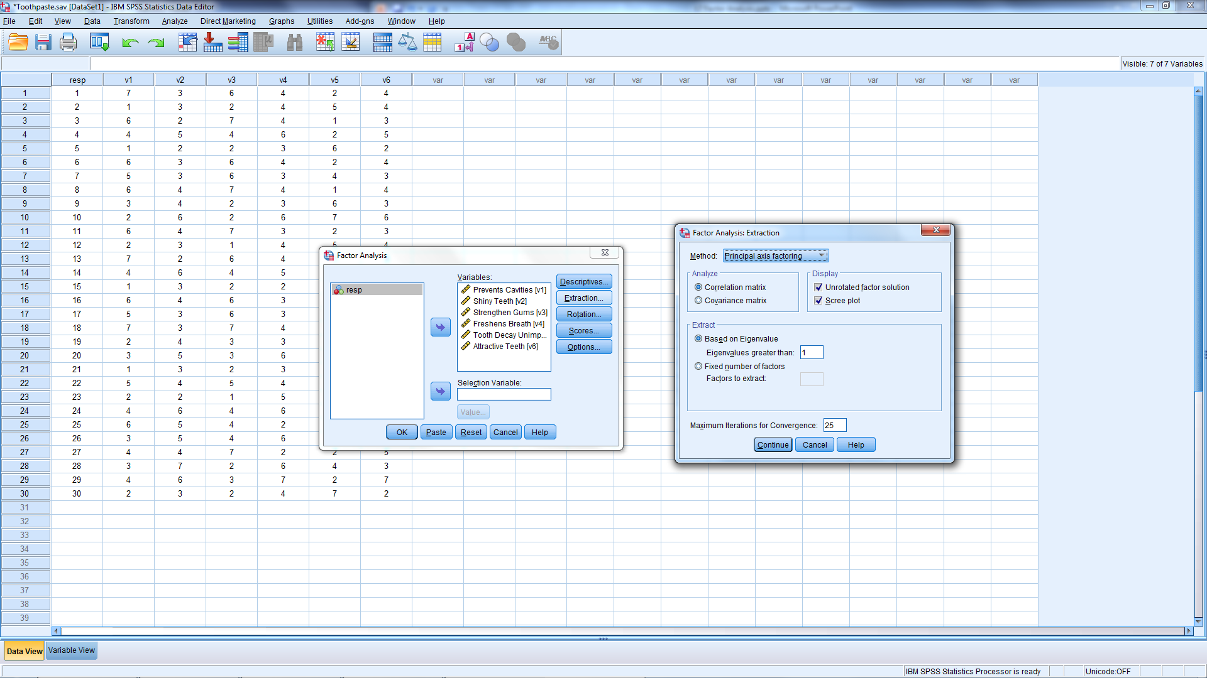
Confirmatory Factor Analysis
Notes:
Change Extraction Method
Tell SPSS how many factors should be extracted
Everything else should be the same

Slide 22
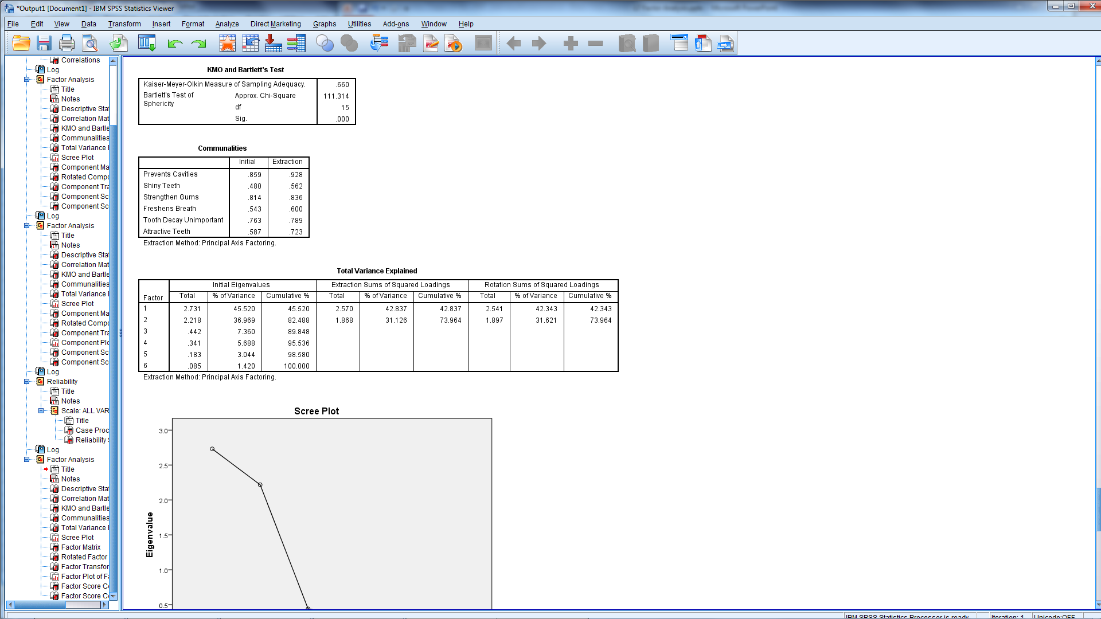
New Output
Notes:
You’ll know if you did something different if it says a different method of extraction.

Slide 23
Key Decisions in Factor Analysis
Should factor analysis be applied to the data?
How many factors should be retained in solution?
Should the initial solution be rotated, and if so, using what rotation scheme?
Which extraction method should be used?
Notes:
Based on Churchill and Iacobucci (2005), Figure 18.8, page 583.
For factor analysis to be appropriate, the variables must be correlated. If the correlations are small, factor analysis may not be appropriate. Factor analysis does not work well if many of the variables are dummy variables.
Typically, principal components is the factor model used, but others are available.
How many factors should be maintained? We used the scree plot, eigenvalue > 1, and % of variance explained to make a decision. Too few factors the output is difficult to interpret, and too many factors is inconsistent with the objective. However, too many is preferred to too few.
Rotation aids interpretation, but does not add additional explanation. So, can experiment with various rotation methods, though varimax is the most popular.
Note: Typically, factor analysis is carried out variable by variables (as here) but there may be occasions where the analysis is object by object.

Slide 24
Correct Number of Factors
A priori
Scree Plot
Percent of Variance Explained (> 60%)
Eigenvalues > 1
Notes:
A prior just means that the analyst has some idea ( from intuition, previous research, or theory) on how many factors should be created.

Slide 25
Key Decisions in Factor Analysis
Should factor analysis be applied to the data?
How many factors should be retained in solution?
Should the initial solution be rotated, and if so, using what rotation scheme?
Which extraction method should be used?
Notes:
Based on Churchill and Iacobucci (2005), Figure 18.8, page 583.
For factor analysis to be appropriate, the variables must be correlated. If the correlations are small, factor analysis may not be appropriate. Factor analysis does not work well if many of the variables are dummy variables.
Typically, principal components is the factor model used, but others are available.
How many factors should be maintained? We used the scree plot, eigenvalue > 1, and % of variance explained to make a decision. Too few factors the output is difficult to interpret, and too many factors is inconsistent with the objective. However, too many is preferred to too few.
Rotation aids interpretation, but does not add additional explanation. So, can experiment with various rotation methods, though varimax is the most popular.
Note: Typically, factor analysis is carried out variable by variables (as here) but there may be occasions where the analysis is object by object.

Slide 26
End of Bite 2 10 min Break

